Slide 1
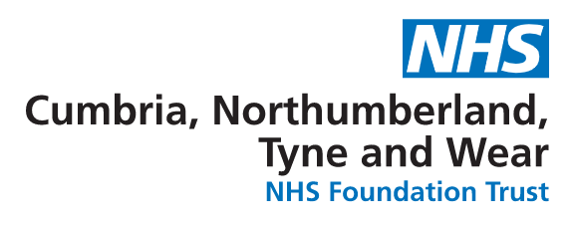

Current and emerging medication options for bipolar disorder
R. Hamish McAllister-Williams,
MD, PhD, FRCPsych
Professor of Affective Disorders, Newcastle University
Hon. Consultant Psychiatrist, Regional Affective Disorders Service, Cumbria, Northumberland Tyne and Wear NHS FT

Slide 2

Disclosure / conflict of interest
I am employed by Newcastle University. I also work clinically in a tertiary level specialist affective disorders service in Cumbria, Northumberland Tyne and Wear NHS Foundation Trust
I have had an interest in relation to one or more organisations that could be perceived as a possible conflict of interest in the context of the subject of this presentation. The relationships are summarised below:
Interest
Speaker fees
Consultancy fees
Independent investigator-
led research support
Commercial research support
Name of organisation
AstraZeneca, Bristol Myers-Squibb, Eli Lilly, Ferrer, GlaxoSmithKline, Janssen-Cilag, LivaNova, Lundbeck, Merck Sharp & Dohme, OM Pharma, Otsuka, Pfizer, Pulse, Roche, Servier, SPIMACO, Sunovian, Wyeth
AstraZeneca, Bristol Myers-Squibb, Cyberonics, Eli Lilly, Ferrer, Janssen-Cilag, LivaNova, Lundbeck, Merck Sharp & Dohme, MyTomorrows, Novartis, Otsuka, Roche, Sage, Servier, Sunovian, Wyeth
AstraZeneca, Eli Lilly, Lundbeck, Wyeth
COMPASS pathways, MagStim
I do not hold any shares in, nor have any ongoing financial relationship with, any pharmaceutical company
Notes:
2

Slide 3
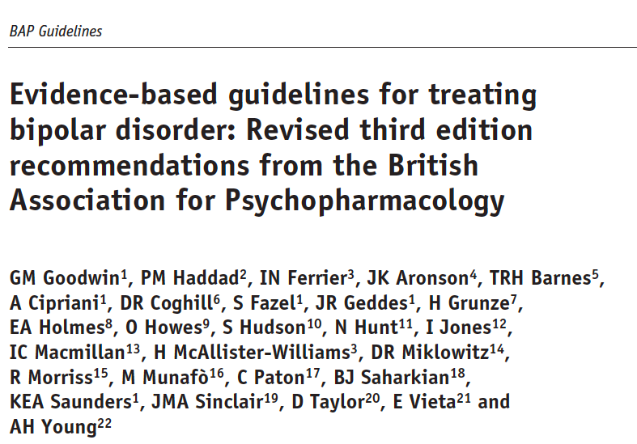

J Psychopharm. 2016 30(6):495-553

Slide 4
The course of Bipolar Disorder
Mania
Hypomania
Euthymia
Minor
Depression
Major
Depression
Preliminary Phase
Preventative Phase

Slide 5
Mania

Slide 6
Acute mania: BAP guidelines
If not already on long-term treatment
  Usually taper and discontinue antidepressants
  Oral antipsychotics (emphasis mostly on “second generation” drugs: e.g. olanzapine, quetiapine, risperidone, aripiprazole)
  Alternatives: lithium, valproate (NOT for women of child-bearing potential), carbamazepine
  Consider benzodiazepines for sleep
Whilst taking long term treatment
  Ensure the highest well-tolerated dose of current treatment offered
  Add an antipsychotic if not already on one
  Add lithium, valproate or carbamazepine if not already on one of these
If inadequate response
  Use clozapine as the antipsychotic
  Electroconvulsive treatment (ECT)

Slide 7
Depression

Slide 8
Acute depression: BAP guidelines
If not already on long-term treatment
  Consider quetiapine, lurasidone, olanzapine or Lamotrigine
  There is great uncertainty about antidepressants
    if antidepressants are used, they should be co-prescribed with a drug for mania
  Consider Electroconvulsive treatment (ECT)
  Lithium if less severe (as prelude to long-term treatment)
Whilst taking long term treatment
  Check doses are adequate and that serum concentrations of lithium are in the therapeutic range
  Address current stressors, if any

Slide 9
Long term treatment

Slide 10
Long term treatment options
There is both placebo controlled trial and naturalistic data supporting the use of lithium, quetiapine, olanzapine, lamotrigine (BAP recommends lithium as 1st line option)
Naturalistic data supports the use of valproate
There is less strong evidence for aripiprazole (lack of naturalistic data) and carbamazepine (limited data)
……….and NB
Lithium, quetiapine (and valproate?) prevent depression AND mania
Olanzapine and aripiprazole (and carbamazepine) prevent mania and not depression
Lamotrigine prevents depression and not mania
………and NB NB
Lithium effect on suicidality
Avoiding Valproate in women of child-bearing potential
Probably avoid carbamazepine if possible
There is no good data supporting the use of long-term antidepressants at least on average
Notes:
10
This slide summarises current recommendations regarding when to start long-term treatment. European guidelines and expert opinion are more conservative than those in the USA. However they both emphasise the need to start long-term treatment early in the course of the disorder.

Slide 11
So, is that it?
New antipsychotics
Novel drug options
Neurostimulation

Slide 12
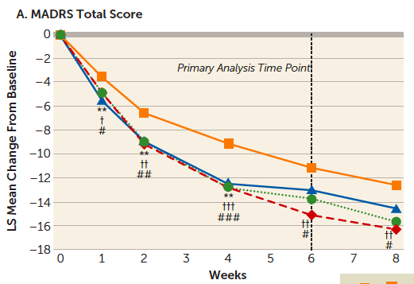
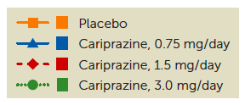
Cariprazine for bipolar depression
Notes:
Cariprazine (RGH-188) is an antipsychotic drug under development by Gedeon Richter. It acts as a D₂ and D₃ receptor partial agonist, with high selectivity towards the D₃ receptor.^{[1]} Positive Phase III study results were published for schizophrenia and mania early 2012, while Phase II studies in bipolar disorder I, and for bipolar depression are in progress.^{[2]} Action on the dopaminergic systems makes it also potentially useful as an add-on therapy in major depressive disorder ^{[3]}
Forest Laboratories obtained a license on development (from the Richter - Hungary) and exclusive commercial rights in the US in 2004

Slide 13
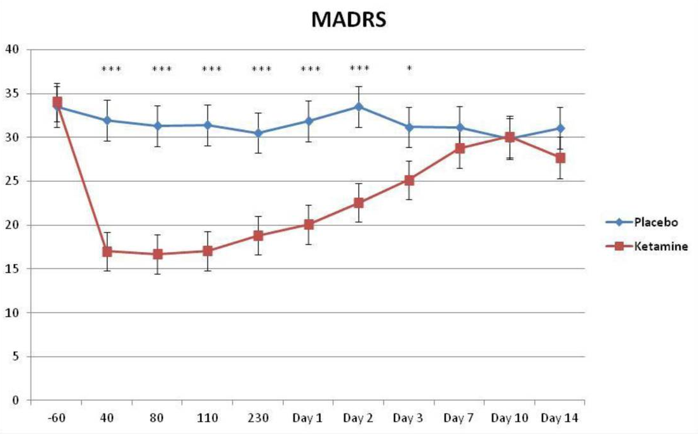
Single intravenous dose of ketamine in bipolar depression
Zarate et al. (2012) Biol Psychiatry. 71(11): 939–946

Slide 14
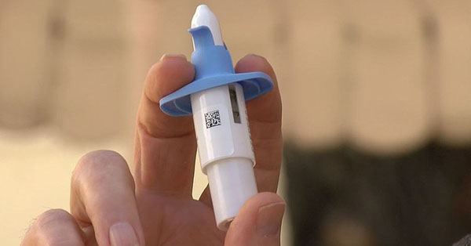
Esketamine nasal spray:
Unipolar treatment resistant depression
LS mean change (±SE) in MADRS total score over time in the double-blind phase
0
Placebo + antidepressant
Esketamine nasal spray + antidepressant
–5
–10
–3.3
(–5.8, –0.8)**
LS mean change (±SE)
in MADRS total score
–2.9
(–5.2, –0.6)**
–15
–2.0
(–4.8, 0.8)**
–3.8
(–6.9, –0.7)**
–20
–4.0
(–7.3, –0.6)**
–25
Baseline
Day 2
(24 hrs)
Day 8
Day 15
Day 22
Day 28
Time (days)
Popova V, et al. Am J Psychiatry 2019;176:428–38.
Notes:
Mean MADRS total score decreased from baseline to day 28, with greater improvement among those treated with esketamine plus AD as compared to AD plus placebo
The response was rapid in onset and increased over time during repeated dosing
Least square mean and SE were based on mixed model for repeated measures (MMRM) with change from baseline as the response variable and the fixed effect model terms for treatment (esketamine + AD, placebo + AD), day, country, class of oral AD, and treatment-by-day and baseline value as a covariate
Note: MADRS total score ranges from 0 to 60; a higher score indicates a more severe condition. Negative change in score indicates improvement
How might an HCP frame a question about this?
How quickly does esketamine work?
You say esketamine works quickly, how quickly and to what extent?
Does esketamine work quickly
You say esketamine works quickly, but didn’t you miss that endpoint

Slide 15
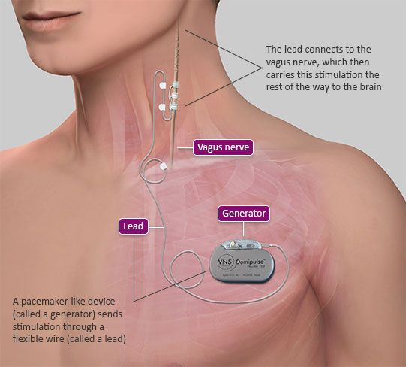

VNS in patients with TRD: 5-year LivaNova registry data
VNS = Vagus nerve stimulation
TAU = Treatment as usual
Cumulative first-time responders by visit month and treatment group: MADRS – VNS D-21 + D-23, TAU (ITT Population)¹
70
VNS + TAU
60
50
40
TAU
Cumulative percent response
30
20
Cumulative response rate at 5 years¹
10
67.6% for VNS + TAU
vs.
40.9% for TAU
(P<0.001; NNT=4)
0
22.3
8
34.4
16
42.8
20.7
50.4
25
53.3
27.2
56.8
29
63.6
33.3
64.4
35.1
66.2
37.3
67.2
38.7
67.8
40.9
VNS
TAU
59.5
31.9
3
6
9
12
18
24
30
36
42
48
54
60
Follow-up visit month
Aaronson ST, et al. Am J Psychiatry 2017;174:640–48
Notes:
For response with VNS 10 months vs. 7 months for TAU. p=0.139

Slide 16
VNS for depression: bipolar vs unipolar disorders
VNS BiPolar
70
VNS UniPolar
60
50
TAU UniPolar
40
TAU BiPolar
Cumulative Percent Responders
30
20
10
0
TAU UniPolar
TAU BiPolar
VNS UniPolar
VNS BiPolar
7
11.5
20.6
26.9
14
23
33.6
36.6
19.6
24.6
40.9
47.8
23.3
31.2
49.1
53.8
26.1
31.2
51.6
57.5
28
32.8
55.5
59.7
31.7
32.8
58.6
61.2
33.1
34.4
62.3
66.4
35
36
63.4
67.9
37.3
37.6
65.4
69.4
39.2
37.6
66.2
70.1
42
37.6
66.8
70.1
3 mo
6 mo
9 mo
12 mo
18 mo
24 mo
30 mo
36 mo
42 mo
48 mo
54 mo
60 mo
Follow-up Visit Month
Aaronson ST, et al. Am J Psychiatry 2017;174:640–48
Notes:
For response with VNS 10 months vs. 7 months for TAU. p=0.139

Slide 17
Principles and practice of managing bipolar disorder?
McAllister-Williams RH, et al. J Affect Disord 2020;267:264–82.

